Slide 1
WEB Programming
Introduction to HTML 4
By : Tamal Dey
Assistant Professor
Dept. of MCA, PESIT

Slide 2
Index
Origins & Evolution of HTML and XHTML
Basic Syntax
Standard HTML Document Structure
Basic Text Markup
Images
Hypertext Links
Lists
Tables
Forms
Frames

Slide 3
Origins and Evolution of HTML
HTML was defined with SGML
Original intent of HTML: General layout of documents that could be displayed by a wide variety of computers
Recent versions:
HTML 3.2 & 4.0 – 1997
  Introduced many new features and deprecated many older features
HTML 4.01 - 1999 - A cleanup of 4.0
XHTML 1.0 – 2000
  Just 4.01 defined using XML, instead of SGML
XHTML 1.1 – 2001
  Modularized 1.0, and drops frames
  We’ll stick to 1.1, except for frames

Slide 4
Basic Syntax
Elements are defined by tags (markers)
Tag format:
  Opening tag: <name>
  Closing tag: </name>
The opening tag and its closing tag together specify a container for the content they enclose
Not all tags have content
  If a tag has no content, its form is <name />
The container and its content together are called an element

Slide 5
If a tag has attributes, they appear between its name and the right bracket of the opening tag
Comment form: <!-- … -->
Browsers ignore comments, unrecognizable tags, line breaks, multiple spaces, and tabs
Tags are suggestions to the browser, even if they are recognized by the browser
The argument that is difficult can be done by XHTML editor
Conversion of HTML to XHTML document can be done using software tools like: http://tidy.sourceforge.net

Slide 6
Basic document structure
<!DOCTYPE html>
<html>
<head> ....………………</head>
<body> ........................... </body>
</html>

Slide 7
Basic Text Markup
Text is normally placed in paragraph elements
Paragraph Elements
The <p> tag breaks the current line and inserts a blank line - the new line gets the beginning of the content of the paragraph
The browser puts as many words of the paragraph’s content as will fit in each line

Slide 8

<P> Tag
<!DOCTYPE html>
<!-- greet.hmtl
A trivial document
-->
<html xmlns = ″http://www.w3.org/1999/xhtml″>
<head> <title> Our first document </title>
</head>
<body>
<p>
Greetings from your Webmaster!
</p>
</body>
</html>

Slide 9
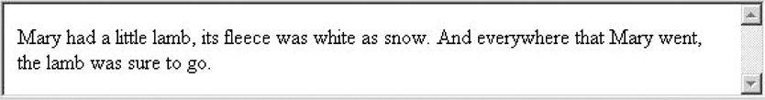
Filling lines
<p>
Mary had
a
little lamb, its fleece was white as snow. And
everithing that
mary went, the lamb
was sure to go.
</p>

Slide 10
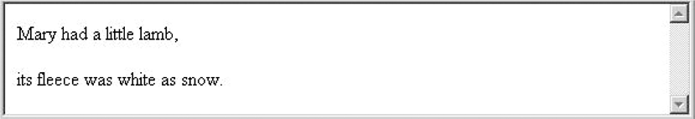
The paragraph element
<p> Mary had a little lamb</p> <p>its fleece was white as show</p>
W3C HTML Validation Service
http://validator.w3.org/file-upload.html

Slide 11
Line breaks
- The effect of the <br /> tag is the same as that of <p>, except for the blank line
No closing tag!
Example of paragraphs and line breaks
On the plains of hesitation <p> bleach the
bones of countless millions </p> <br />
who, at the dawn of victory <br /> sat down
to wait, and waiting, died.

Slide 12
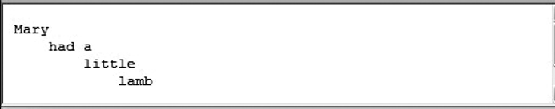
The pre element (Preserving Whitespace)
<pre>
Mary
had a
little
lamb
</pre>
A pre element can contain virtually any other tags, except that cause a paragraph break, such as paragraph elements.

Slide 13
Headings
Six sizes, 1 - 6, specified with <h1> to <h6>
1, 2, and 3 use font sizes that are larger than the default font size
4 uses the default size
5 and 6 use smaller font sizes

Slide 14
Headings
<!-- headings.html
An example to illustrate headings
-->
<html xmlns = ″http://www.w3.org/1999/xhtml″>
<head> <title> Headings </title>
</head>
<body>
<h1> Aidan’s Airplanes (h1) </h1>
<h2> The best in used airplanes (h2) </h2>
<h3> "We’ve got them by the hangarful" (h3)
</h3>
<h4> We’re the guys to see for a good used
airplane (h4) </h4>

Slide 15
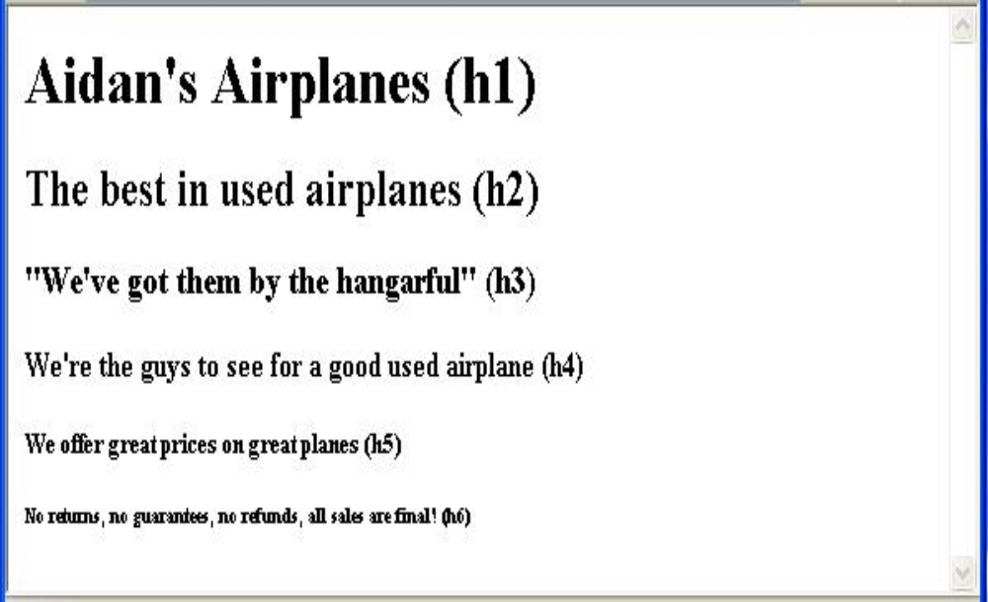
Headings
<h5> We offer great prices on great planes
(h5) </h5>
<h6> No returns, no guarantees, no refunds,
all sales are final (h6) </h6>
</body>
</html>

Slide 16
Blockquotes
Content of <blockquote>
To set a block of text off from the normal flow and appearance of text
Browsers often indent on left or right side or both, and sometimes italicize
Font Styles and Sizes (can be nested)
  Boldface - <b>
  Italics - <i>
  Larger - <big>
  Smaller - <small>
  Monospace - <tt>

Slide 17
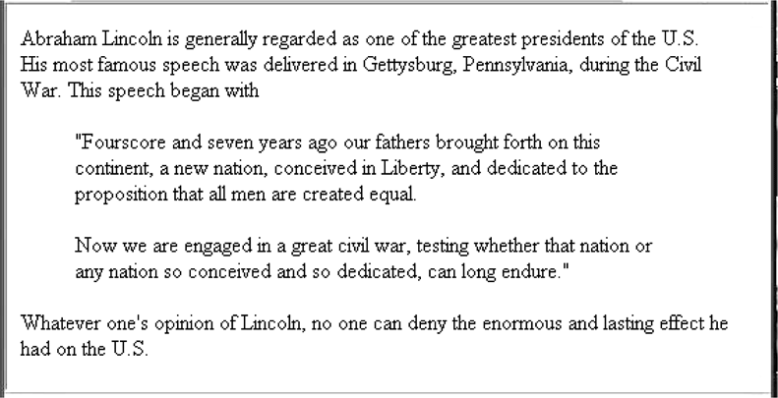
Display of blockquote.html

Slide 18
Nested element
The <big> sleet <big> in <big> <i> Crete </i><br /> lies </big> completely </big> in </big> the street
Output
  The sleet in Crete
  lies completely in the street

Slide 19
Inline vs block elements
Block Elements: Block level elements normally start (and end) with a new line when displayed in a browser.
  Examples: <h1>, <p>, <ul>, <table>
Inline Elements: Inline elements are normally displayed without starting a new line.
  Examples: <b>, <td>, <a>, <img>
Block elements CANNOT be nested in inline elements

Slide 20

Superscripts and subscripts
  Subscripts with <sub>
  Superscripts with <sup>
Example: x<sub>2</sub><sup>3</sup>
  Display: x₂³

Slide 21
Character Entities
Char. Entity Meaning
& &amp; Ampersand
< &lt; Less than
> &gt; Greater than
" &quot; Double quote
' &apos; Single quote
¼ &frac14; One quarter
½ &frac12; One half
¾ &frac34; Three quarters
° &deg; Degree
(space) &nbsp; Non-breaking space

Slide 22
Double Digit Fraction
The key to writing fractions, in HTML, this way is the HTML fraction slash entity. This is created with the following HTML entity....
  &frasl;
    1&frasl;10
      1⁄10
        ... which, as you can see, doesn't look right.
    <sup>1</sup>&frasl;<sub>10</sub>
      ¹⁄₁₀

Slide 23
Horizontal rules
<hr /> draws a line across the display, after a line break
  Attributes are size, color etc.
The meta element
The meta element (for search engines)
Used to provide additional information about a document, with attributes, not content
  <meta name="sample” http-equiv="content-type" content="text/html; charset=UTF-8" />

Slide 24
HTML Syntax Rules
Attribute names must be in lowercase
  type="text/css"
Attribute values must be quoted
The id attribute replaces the name attribute
  The id selector is used to specify a style for a single, unique element
  The id selector uses the id attribute of the HTML element, and is defined with a "#".
#para1
{
text-align:center;
color:red;
}

Slide 25
Tags
<!--...--> - Defines a comment
<html> - Defines an html document
<head> - Defines information about the document
<title> - Defines the document title
<body> - Defines the body element
<p> - Defines a paragraph
<h1>..<h6> - Defines header 1 to header 6
<font> - Defines text font, size, alien and color
<a> - Defines an anchor

Slide 26
Basic Tags
<b> - Defines bold text
<i> - Defines italic text
<u> - Defines underlined text
<big> - Defines big text <small> : Defines small text
<strong> - Defines strong text
<br /> - Inserts a single line break
<div> - Defines a section in a document
<hr /> - Defines a horizontal rule
<img> - Defines an image

Slide 27
<form> : Defines a form element in web page
<sub> : Defines a subscript text
<sup>: Defines a superscript text
<input> : used to select user information
<select> : create a select list (drop-down list).
<option> : select element define the available options in the list.
<link> :defines the relationship between a document and an external resource
<center> : used to center text.

Slide 28
<frame>/<frameset>: define single frame /defines a frameset.
<iframe> tag defines an inline frame that contains another document.
<del> tag defines text that has been deleted from a document.
  <p>My favorite color is <del>blue</del> <ins>red</ins>!</p>
<menu>: Defines create a list of menu choices
<script> : Defines a client-side script, such as a JavaScript
<textarea>: Defines a multi-line text input control.

Slide 29
Tags
<input> - Defines an input field
<center> : Defines centered content
<font> and <basefont> : Defines HTML fonts
<s> and <strike> : Defines strikethrough text
<u> : Defines underlined text Attributes
Attributes
align : Defines the alignment of text
bgcolor: Defines the background color
color Defines the text color

Slide 30
Tags
<ol> - Defines an ordered list
<ul> - Defines an unordered list
<li> - Defines a list item
<dl> - Defines a definition List
<span> - Defines a section in a document
<table> - Defines a table
<th> - Defines a table header
<tr> - Defines a table row
<td> - Defines a table cell
<col> : attribute values for one or more columns in a table

Slide 31
Images
GIF (Graphic Interchange Format) – jif-fy, 1987
  8-bit /Pixel color (256 different colors)
JPEG (Joint Photographic Experts Group) – jay-peg
  24-bit color/Pixel (16 million different colors)
Both use compression, but JPEG compression is better
Images are inserted into a document with the <img /> tag with the src attribute
The alt attribute is required by HTML
  Purposes:
1. Non-graphical browsers
2. Browsers with images turned off

Slide 32
<img src = "comets.jpg“ alt= "Picture of comets” />
The <img> tag has 30 different attributes, including width and height (in pixels)
  http://www.w3.org/TR/html401/index/attributes.html
Portable Network Graphics (PNG) –ping - 1996
  Bitmap format, transparent and larger number of colors
  Should eventually replace both gif and jpeg
  Information about PNG can be found in www.w3.org/Graphics/PNG

Slide 33
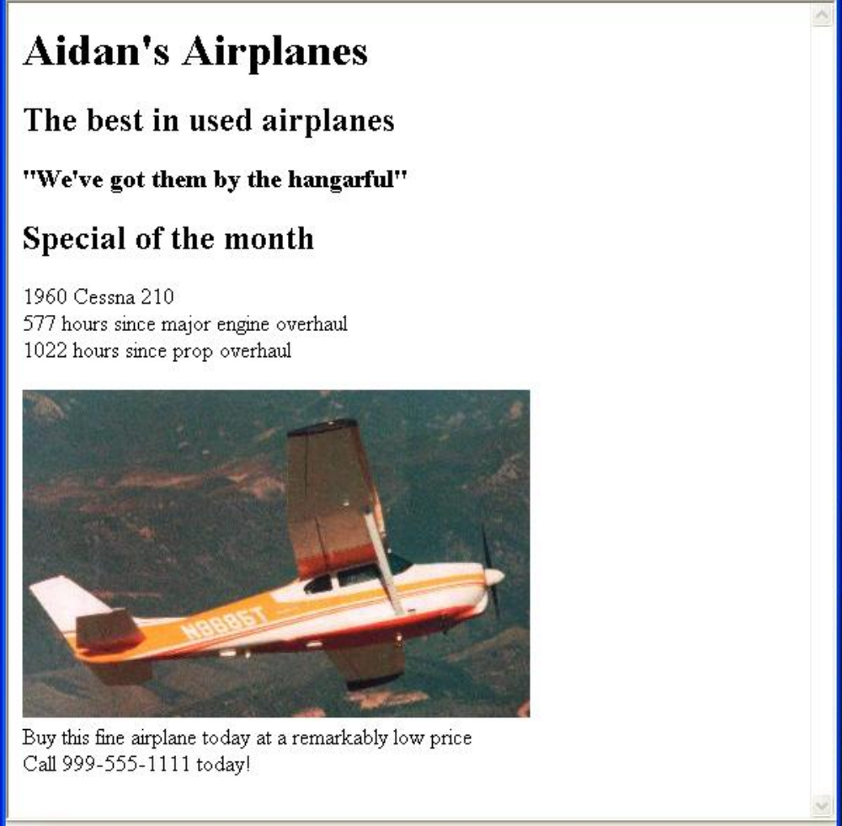

Slide 34
Hypertext Links
Hypertext is the essence of the Web!
A link is specified with the href (hypertext reference) attribute of <a> (the anchor tag)
The content of <a> is the visual link in the document
If the target is a whole document (not the one in which the link appears), the target need not be specified in the target document as being the target
  Note: Relative addressing of targets is easier to maintain and more portable than absolute addressing
http://www.rxs-enterprises.org/fp/articles/9988/10/37/40/Relative_and_Absolute_Addressing.aspx#ans

Slide 35
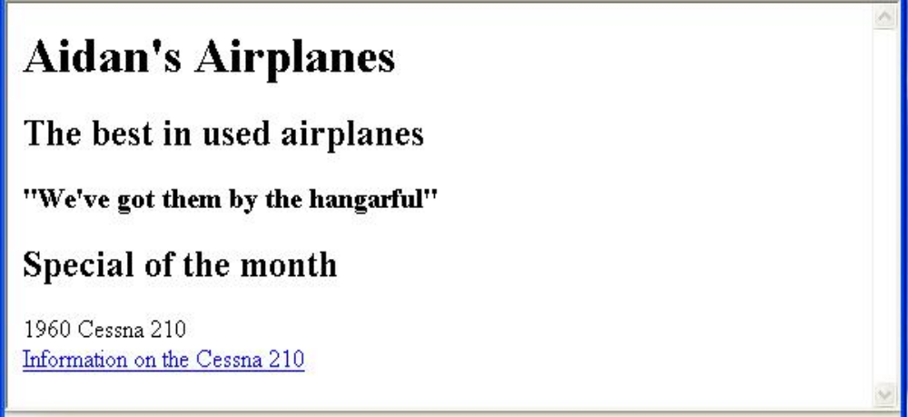
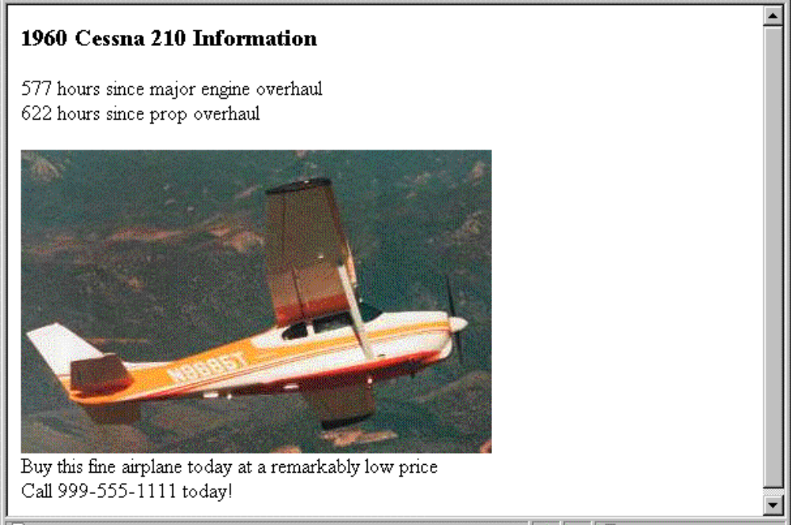

Slide 36
Hypertext Links (continued)
If the target is not at the beginning of the document, the target spot must be marked
Target labels can be defined in many different tags with the id attribute, as in
  <h1 id = "baskets"> Baskets </h1>
The link to an id must be preceded by a pound sign (#); If the id is in the same document, this target could be
  <a href = "#baskets"> What about baskets? </a>
If the target is in a different document, the document reference must be included
  <a href = "myAd.html#baskets”> Baskets </a>

Slide 37
Style note: a link should blend in with the surrounding text, so reading it without taking the link should not be made less pleasant
Links can have images:
  <a href = "c210data.html“>
  <img src = "smallplane.jpg“ alt = "Small picture of an airplane " /> Info on C210 </a>

Slide 38
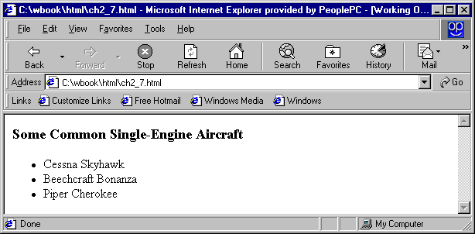
Lists
Unordered lists
  The list is the content of the <ul> tag
  List elements are the content of the <li> tag
Example
<h3> Some Common Single-Engine Aircraft </h3>
<ul>
<li> Cessna Skyhawk </li>
<li> Beechcraft Bonanza </li>
<li> Piper Cherokee </li>
</ul>

Slide 39
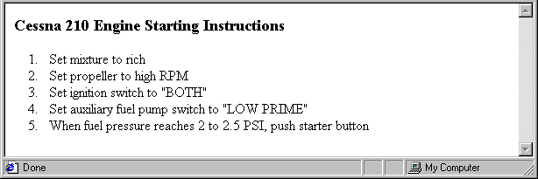
Ordered lists
  The list is the content of the <ol> tag
  Each item in the display is preceded by a sequence value
<h3> Cessna 210 Engine Starting Instructions</h3>
<ol>
<li> Set mixture to rich </li>
<li> Set propeller to high RPM </li>
<li> Set ignition switch to "BOTH" </li>
<li> Set auxiliary fuel pump switch to
"LOW PRIME" </li>
<li> When fuel pressure reaches 2 to 2.5 PSI, push starter button </li>
</ol>

Slide 40
Nested lists
Any type list can be nested inside any type list
The nested list must be in a list item
Example

Slide 41
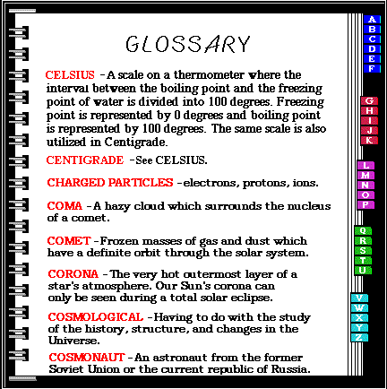
Definition lists (for glossaries, etc.)
  List is the content of the <dl> tag
  Terms being defined are the content of the <dt> tag
  The definitions themselves are the content of the <dd> tag

Slide 42
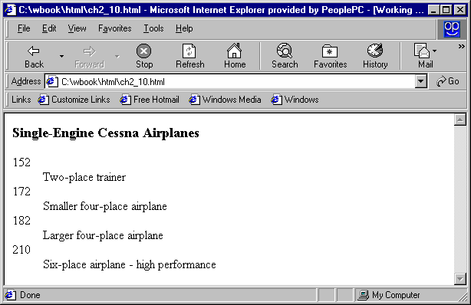
<h3> Single-Engine Cessna Airplanes </h3>
<dl >
<dt> 152 </dt>
<dd> Two-place trainer </dd>
<dt> 172 </dt>
<dd> Smaller four-place airplane </dd>
<dt> 182 </dt>
<dd> Larger four-place airplane </dd>
<dt> 210 </dt>
<dd> Six-place airplane - high performance
</dd>
</dl>

Slide 43
Definition List
<dl> : Definition List
<dt> : Definition term
<dd> : Data description
  <dl>
  <dt>Coffee</dt>
  <dd>- black color hot drink</dd>
  <dt>Milk</dt>
  <dd>- white color cold /hot drink</dd>
  </dl>

Slide 44
Tables
A table is a matrix of cells, each possibly having content
The cells can include almost any element
Some cells have row or column labels and some have data
A table is specified as the content of a <table> tag
A border attribute in the <table> tag specifies a border between the cells
If border is set to "border", the browser’s default width border is used
The border attribute can be set to a number, which will be the border width without the border attribute, the table will have no lines!

Slide 45
caption
Tables are given titles with the <caption> tag, which can immediately follow <table>
Each row of a table is specified as the content of a <tr> tag
The row headings are specified as the content of a <th> tag
The contents of a data cell is specified as the content of a <td> tag

Slide 46
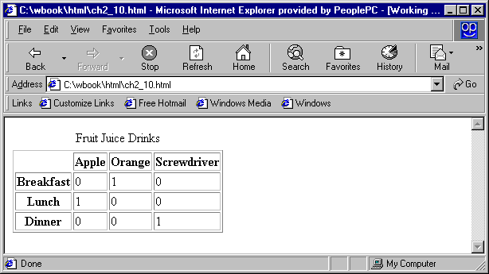
<tr>
<th> Breakfast </th>
<td> 0 </td>
<td> 1 </td>
<td> 0 </td>
</tr>
<tr>
<th> Lunch </th>
<td> 1 </td>
<td> 0 </td>
<td> 0 </td>
</tr>
</table>
<table border = "border">
<caption> Fruit Juice Drinks </caption>
<tr>
<th> </th>
<th> Apple </th>
<th> Orange </th>
<th> Screwdriver</th>
</tr>

Slide 47
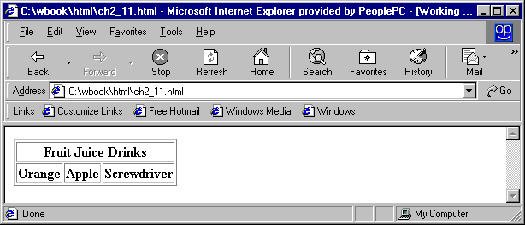
rowspan & colspan
A table can have two levels of column labels
If so, the colspan attribute must be set in the <th> tag to specify that the label must span some number of columns
<tr>
<th colspan = "3"> Fruit Juice Drinks </th>
</tr>
<tr>
<th> Orange </th>
<th> Apple </th>
<th> Screwdriver </th>
</tr>

Slide 48
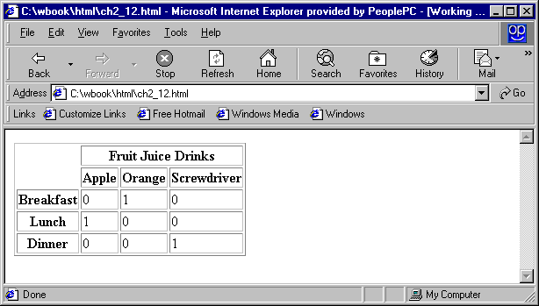
If the rows have labels and there is a spanning column label, the upper left corner must be made larger, using rowspan
<table border = "border">
<tr>
<td rowspan = "2"> </td>
<th colspan = "3"> Fruit Juice Drinks</th> </tr>
<tr>
<th> Apple </th>
<th> Orange </th>
<th> Screwdriver </th>
</tr>
…/</table>
</tr>

Slide 49
align
The align attribute controls the horizontal placement of the contents in a table cell
Values are left, right, and center
align is an attribute of <tr>, <th>, and <td> elements
The valign attribute controls the vertical placement of the contents of a table cell
Values are top, bottom, and center (default)
valign is an attribute of <th> and <td> elements
→ SHOW cell_align.html and display it

Slide 50
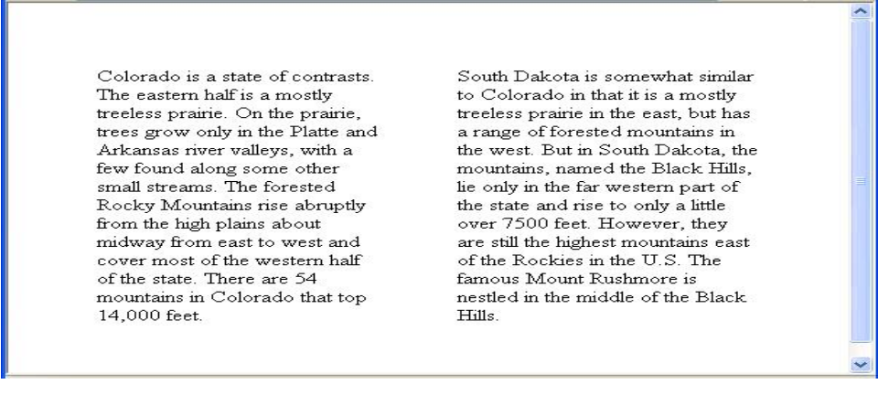
The cellpadding attribute of <table> is used to specify the spacing between the content of a cell and the inner walls of the cell
The cellspacing attribute of <table> is used to specify the distance between cells in a table
<table cellspacing = "50">
<tr>
<td> Colorado is a state of …
</td>
<td> South Dakota is somewhat…
</td>
</tr> Example1 2
</table>
`

Slide 51
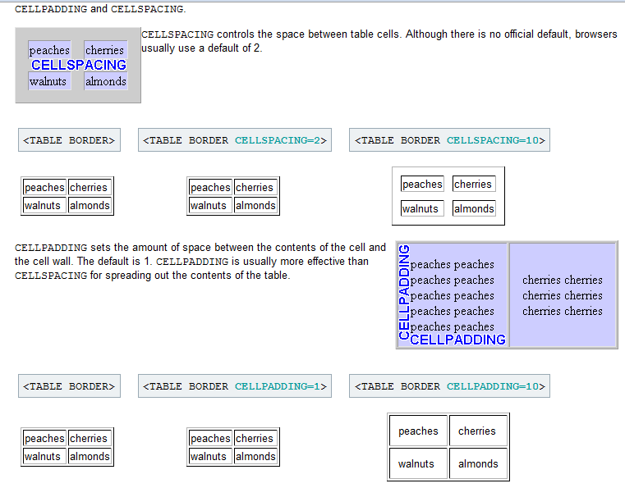


Slide 52
Table Sections
Header, body, and footer, which are the elements:
  thead, tbody, and tfoot
If a document has multiple tbody elements, they are separated by thicker horizontal lines
Nested Table

Slide 53
FORMS
A form is the usual way information to communicate a browser to a server
HTML has tags to create a collection of objects that implement this information gathering
The objects are called controls or widgets (e.g., radio buttons and checkboxes)
When the Submit button of a form is clicked, the form’s values are sent to the server
All of the widgets, or components of a form are defined in the content of a <form> tag

Slide 54
The only required attribute of <form> is action, which specifies the URL of the application that is to be called when the Submit button is clicked
  action = http://www.cs.ucp.edu/cgi-bin /survey.pl
If the form has no action, the value of action is the empty string (“ ”)
The method attribute of <form> specifies one of the two possible techniques of transferring the form data to the server, get and post

Slide 55
Common controls are created with the <input> tag
The type attribute of <input> specifies the kind of widget being created
1. Text
  Creates a horizontal box for text input
  Often default size is 20; it can be changed with the size attribute
  If more characters are entered than will fit, the box is scrolled (shifted) left
  If you don’t want to allow the user to type more characters than will fit, set maxlength, which causes excess input to be ignored
<input type = "text" name = "Phone“ size = "12" >

Slide 56
2. Checkboxes - to collect multiple choice input
  Every checkbox requires a value attribute, which is the widget’s value in the form data when the checkbox is ‘checked’
  A checkbox that is not ‘checked’ contributes no value to the form data
  By default, no checkbox is initially ‘checked’
  To initialize a checkbox to ‘checked’, the checked attribute must be set to "checked“
  Example

Slide 57
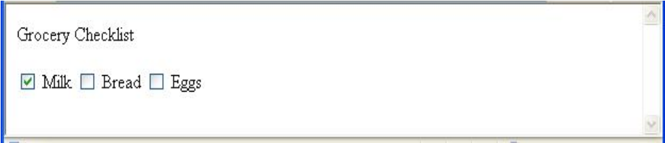
Grocery Checklist
<form action = "">
<p>
<input type = "checkbox" name ="groceries"
value = "milk" checked = "checked">
Milk
<input type = "checkbox" name ="groceries"
value = "bread">
Bread
<input type = "checkbox" name = "groceries"
value= "eggs">
Eggs
</p>
</form>

Slide 58
3. Radio Buttons - collections of checkboxes in which only one button can be ‘checked’ at a time
Every button in a radio button group MUST have the same name
If no button in a radio button group is ‘pressed’, the browser often ‘presses’ the first one
Age Category
<form action = "">
<p>
<input type = "radio" name = "age"
value = "under20" checked = "checked"> 0-19

Slide 59
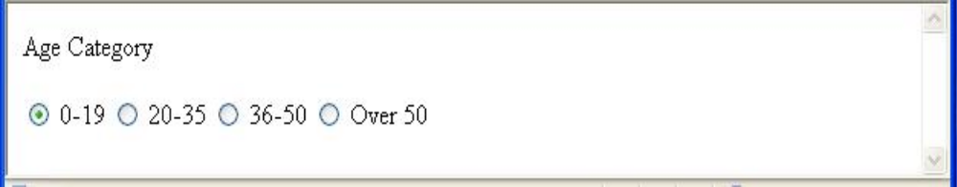
<input type = "radio" name = "age"
value = "20-35"> 20-35
<input type = "radio" name = "age"
value = "36-50"> 36-50
<input type = "radio" name = "age"
value = "over50"> Over 50
</p>
</form> Output

Slide 60
4. Menus - created with <select> tags
  There are two kinds of menus, those that behave like checkboxes and those that behave like radio buttons (the default)
  Menus that behave like checkboxes are specified by including the multiple attribute, which must be set to "multiple“
  The name attribute of <select> is required
  The size attribute of <select> can be included to specify the number of menu items to be displayed (the default is 1)

Slide 61
Example
  If size is set to > 1 or if multiple is specified, the menu is displayed as a pop-up menu
  Each item of a menu is specified with an <option> tag, whose pure text content (no tags) is the value of the item
  An <option> tag can include the selected attribute, which when assigned "selected“ specifies that the item is preselected

Slide 62
Grocery Menu - milk, bread, eggs, cheese
<form action = "">
<p>
With size = 1 (the default)
<select name = "groceries">
<option> milk </option>
<option> bread </option>
<option> eggs </option>
<option> cheese </option>
</select>
</p>
</form>

Slide 63
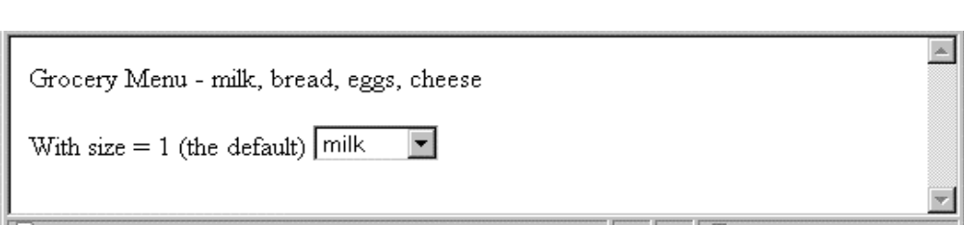
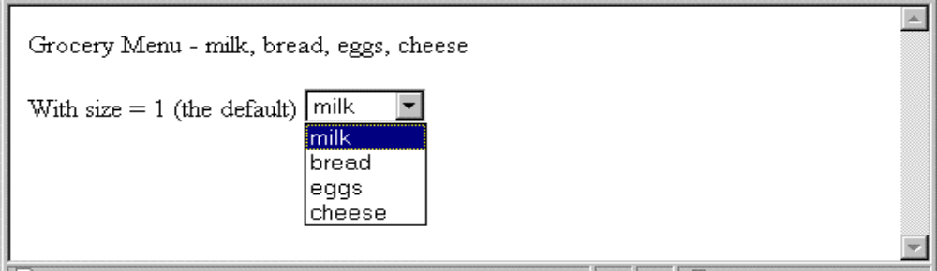
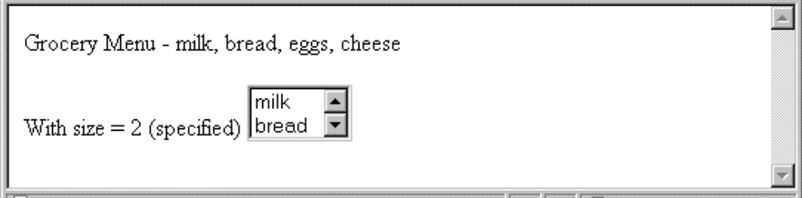
After clicking the menu:
After changing size to 2:

Slide 64
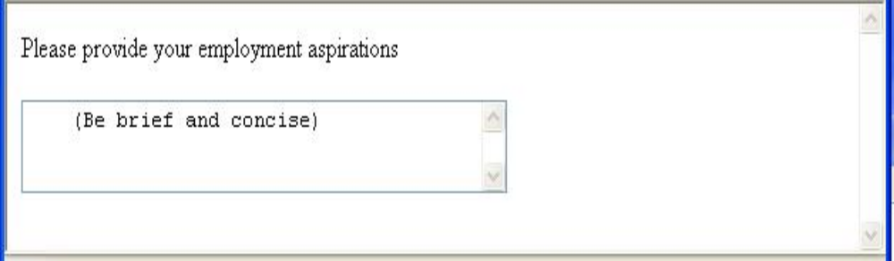
5. Text areas - created with <textarea>
  Usually include the rows and cols attributes to specify the size of the text area
  Default text can be included as the content of <textarea>
  Scrolling is implicit if the area is overfilled
Please provide your employment aspirations
<form action = "“> <p>
<textarea name = "aspirations" rows = "3” cols = "40“> (Be brief and concise)
</textarea>
</p>
</form> Example

Slide 65
6. Reset and Submit buttons
  Both are created with <input>
  <input type = "reset" value = "Reset Form">
  <input type = "submit” value = "Submit Form">
Submit has two actions:
1. Encode the data of the form
2. Request that the server execute the server-resident program specified as the value of the action attribute of <form>
A Submit button is required in every form
  → popcorn.html and display it
  Form.html

Slide 66
Frames
Frames are rectangular sections of the display window, each of which can display a different document
The <frameset> tag specifies the number of frames and their layout in the window
<frameset> takes the place of <body>
  Cannot have both!
<frameset> must have either a rows attribute or a cols attribute, or both (usually the case)
  Default is 1

Slide 67
The possible values for rows and cols are numbers, percentages, and asterisks
A number value specifies the row height in pixels - Not terribly useful!
A percentage specifies the percentage of total window height for the row - Very useful!
An asterisk after some other specification gives the remainder of the height of the window

Slide 68
Examples:
<frameset rows = “200, 300, 400">
<frameset rows = "25%, 50%, 25%">
<frameset rows = "50%, 20%, *" >
<frameset rows = “33%, 33%, 33%” cols = “25%, *">

Slide 69
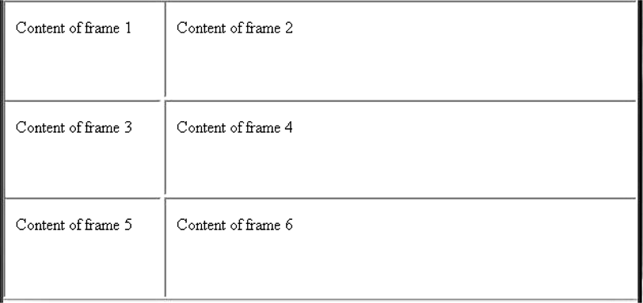
Nested frames - to divide the screen in more interesting ways

Slide 70
The <frame> tag specifies the content of a frame
The first <frame> tag in a <frameset> specifies the content of the first frame, etc.
  Row-major order is used
Frame content is specified with the src attribute
Without a src attribute, the frame will be empty (such a frame CANNOT be filled later)
If <frameset> has fewer <frame> tags than frames, the extra frames are empty

Slide 71
Scrollbars are implicitly included if needed
  they are needed if the specified document will not fit
If a name attribute is included, the content of the frame can be changed later (by selection of a link in some other frame)
  →frames.html

Slide 72
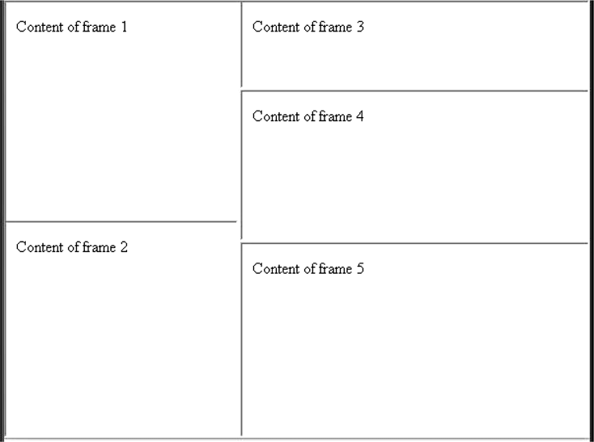
nested_frames.html

Slide 73
contents.html
<!--The contents of the first frame of
frames.html, which is the table of
contents for the second frame -->
<html xmlns = ″http://www.w3.org/1999/xhtml″>
<head>
<title> Table of Contents Frame</title>
</head>
<body>
<h4> Fruits </h4>
<ul>
<li> <a href = "apples.html"
target = "descriptions"> apples </a>

Slide 74
<li>
<a href = "bananas.html"
target = "descriptions">
bananas </a>
<li>
<a href = "oranges.html"
target = "descriptions">
oranges </a>
</ul>
</body>
</html>

Slide 75
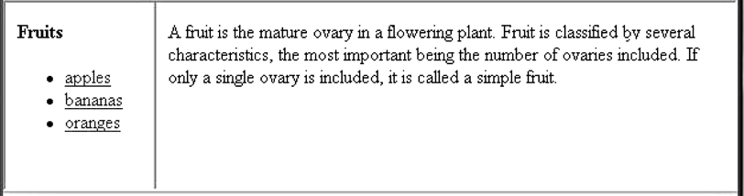
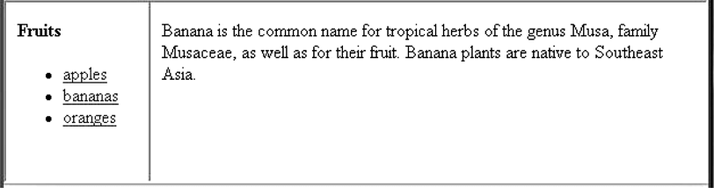

Slide 76
iframe
An inline frame is marked up as follows:
  <iframe src="http://google.co.in"></iframe>
An inline frame is used to embed another document within the current HTML document.
The height and width attributes are used to specify the height and width of the iframe.
The attribute values are specified in pixels by default, but they can also be in percent (like "80%").
The frameborder attribute specifies whether or not to display a border around the iframe.
Set the attribute value to "0" to remove the border:

Slide 77
Deprecated HTML tags
Deprecated | Description | Replacement
<applet> | Inserts applet | <object>
<basefont> | sets font styles | font style sheets
<center> | centers elements | <div style="text-align:center“>
<dir> | directory list | <ul>
<font> | applies font styles | font style sheets
<isindex> | adds search field | <form>
<menu> | menu list | <ul>
<s> | strike through | text style sheets
<strike> | strike through | text style sheets
<u> | underline | text style sheets

Slide 78
Deprecated HTML attributes
Attribute | Deprecated if used in
align | <caption>, <img>, <table>, <hr>,
 | <div>, <h1..6>, <p>
alink | <body>
background | <body>
bgcolor | <body>, <table> <tr> <td> <th>
clear | <br>
compact | <ol>, <ul>
color | <basefont>, <font>
border | <img>, <object>
vspace | <img>,<object>
Attribute | Deprecated if used in
hspace | <img>,<object>
link | <body>
noshade | <hr>
nowrap | <td>, <th>
size | <basefont>,<font>, <hr>
start | <ol>
text | <body>
type | <li>
value | <li>
vlink | <body>
width | <hr>, <pre>, <td>, <th>

Slide 79
The following HTML 4.01 elements are removed from HTML5:
<acronym>
<applet>
<basefont>
<big>
<center>
<dir>
<font>
<frame>
<frameset>
<noframes>
<strike>
<tt>
http://www.w3schools.com/tags/default.asp

Slide 80
Sl. | Question Bank | Marks
1. | Explain the following with example: Paragraph Preserving whitespaces Headings Character entities Blockquotes | 2*5
2. | Explain in detail about Images and Hypertext Links. | 3+3
3 | Explain Lists with its types with suitable example. | 6
4. | Explain the following with examples: Tables Forms Frames Absolute and Relative file addressing | 2.5*4
5. | Explain about rowspan and colspan attribute. | 5
6. | Explain frame, frameset and iframe with example. | 7
7. | Programs on all the topics mentioned in table of contents. | -

Slide 81



